Slide 1
EDA CAPSTONE PROJECT - 1
EDA ON HOTEL BOOKING ANALYSIS
Team – Vipin Kalia

Slide 2
Problem Context
Have you ever wondered when the best time of year to book a hotel room is? Or the optimal length of stay in order to get the best daily rate? What if you wanted to predict whether or nt a hotel was likely to receive a disproportionately high number of special requests? This hotel booking dataset can help you explore those questions! This data set contain booking information for a city hotel and a resort hotel, and includes information such as when the booking was made, length of stay, the number of adults, children, and/or babies, and the number of available parking spaces, among other things. All personally identifying information has been removed from the data. Explore and analysis the data to discover important factors that govern the bookings.

Slide 3
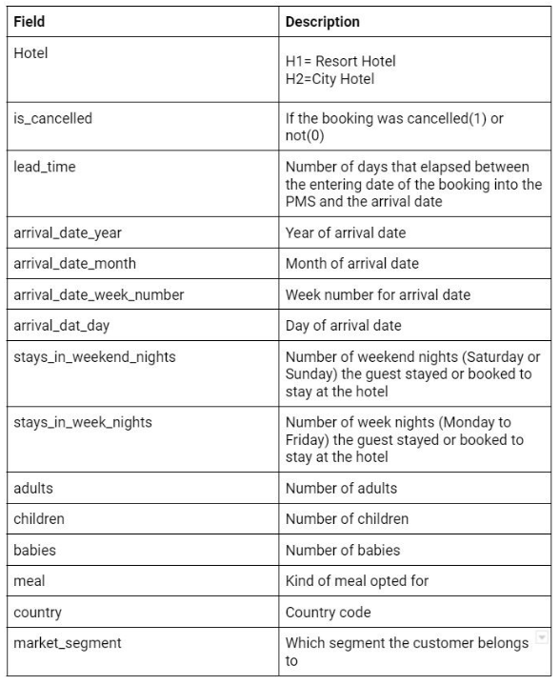
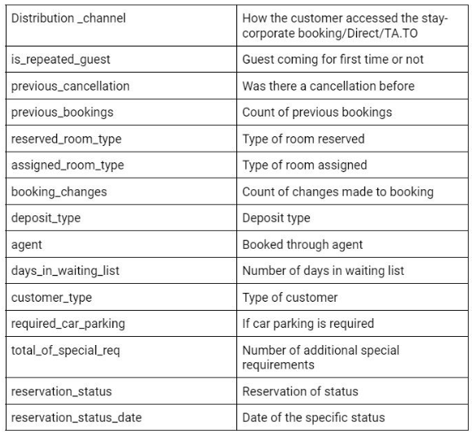
Data Description

Slide 4
Agenda
We try to answer following questions for Hotel Booking:
Which Hotel Generates the highest revenues?
Which room type attracts the more guests?
Average of canceled and not canceled bookings?
Which are the effective months for hotels chain?
What is the average of the repeated guests?
What are the total stays in nights?
Which hotel meal is most preferable by the guests?

Slide 5
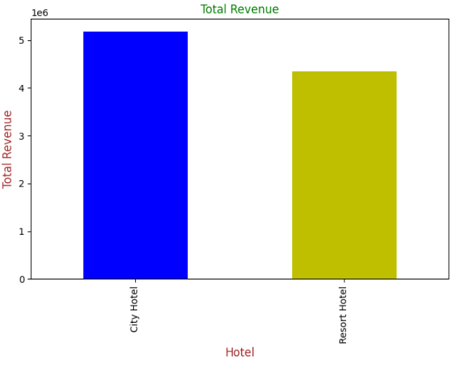
Total Revenue Generated by the Hotels
The visualization clearly shows that the ‘City Hotel’ Generates the more revenue as compared to the Hotel ‘Resort Hotel’.

Slide 6
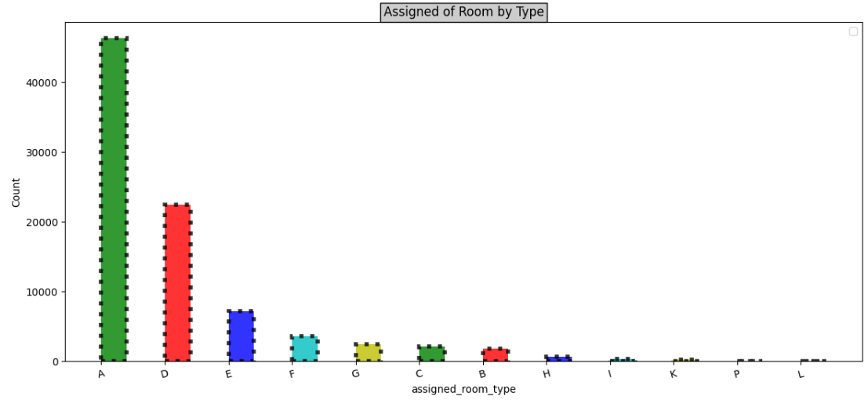
Which room type attracts the more guests?
This insights shows that Room Type ‘A’, ‘D’, ‘E’ provides the better services to the guests.
These three room are the best choice by the guests.

Slide 7
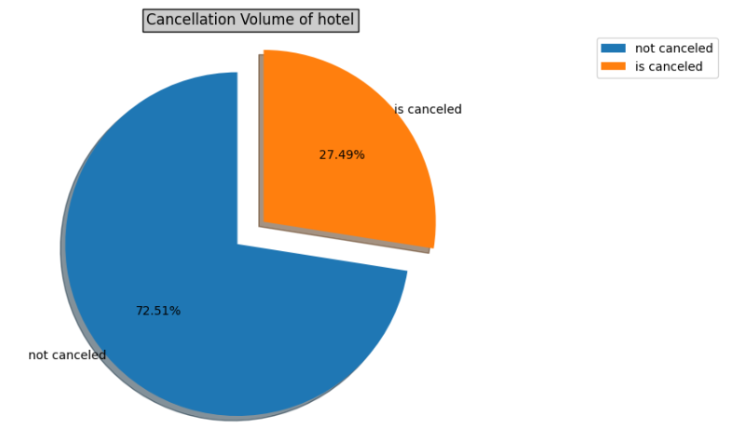
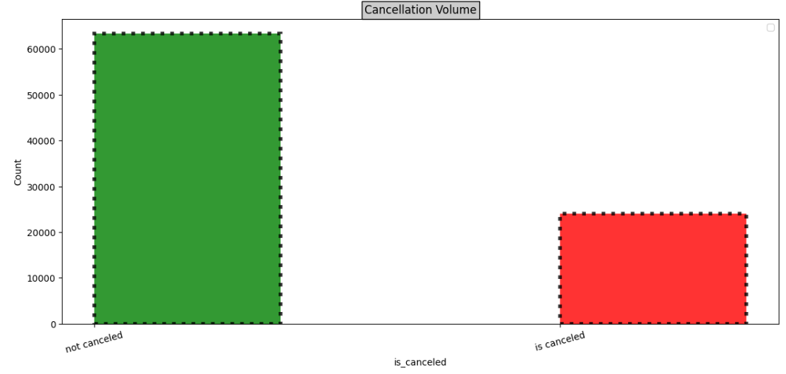
Average of canceled and not canceled bookings
Percentage of cancelled booking is less.
This percentage of cancelled bookings can have impact the business.

Slide 8
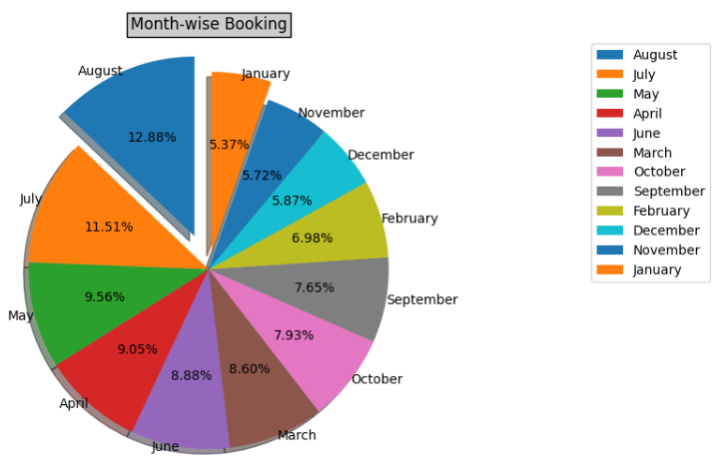
Effective Months
July, May and August are the most effective months among all 12.
As these above months are the vacations month so these months always have the higher chances for hotel bookings.

Slide 9
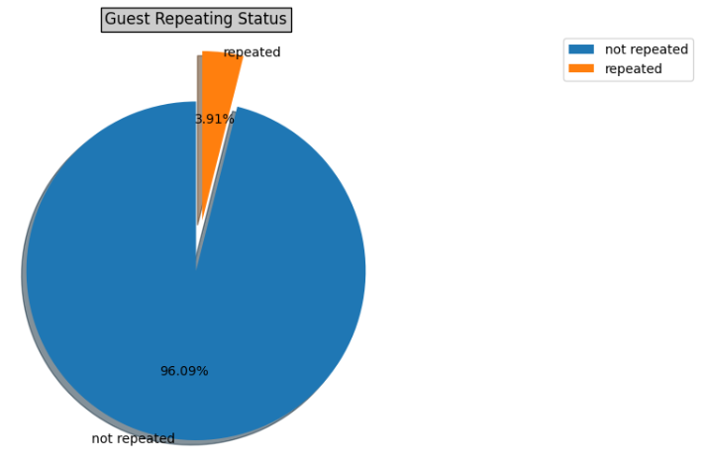
Average of Repeated Guests
Very Less percentage of guests are repeated i.e., only 3.91%.
There is high chances of new guest to check-in the hotels.

Slide 10
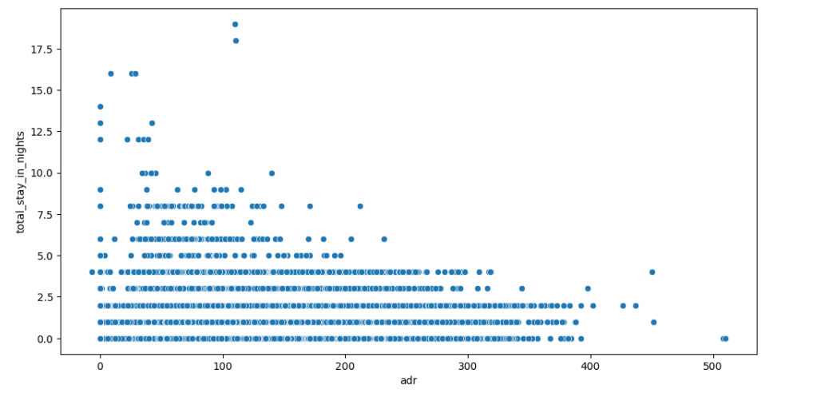
Total stays in nights
As we can see, usually most of the guests stay for five nights.
There is rare number of guest who stay only 10-17 nights.

Slide 11
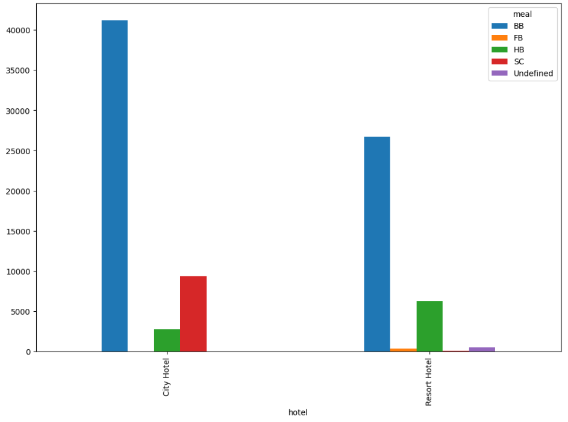
Different meals of both the hotels
BB (Bread Butter) is in the high demand amongst the different meals of both the hotels.
SC has also in demand of City Hotel.

Slide 12
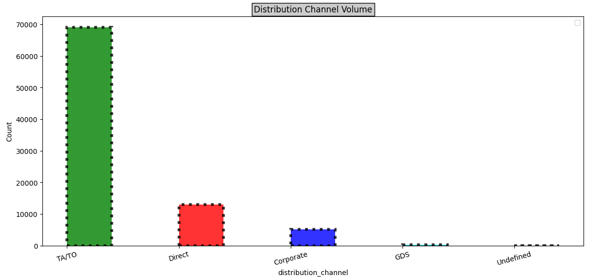
Distribution Channel Volume
As we can clearly see that the TA/TO is the most preferable choice by the guest.

Slide 13
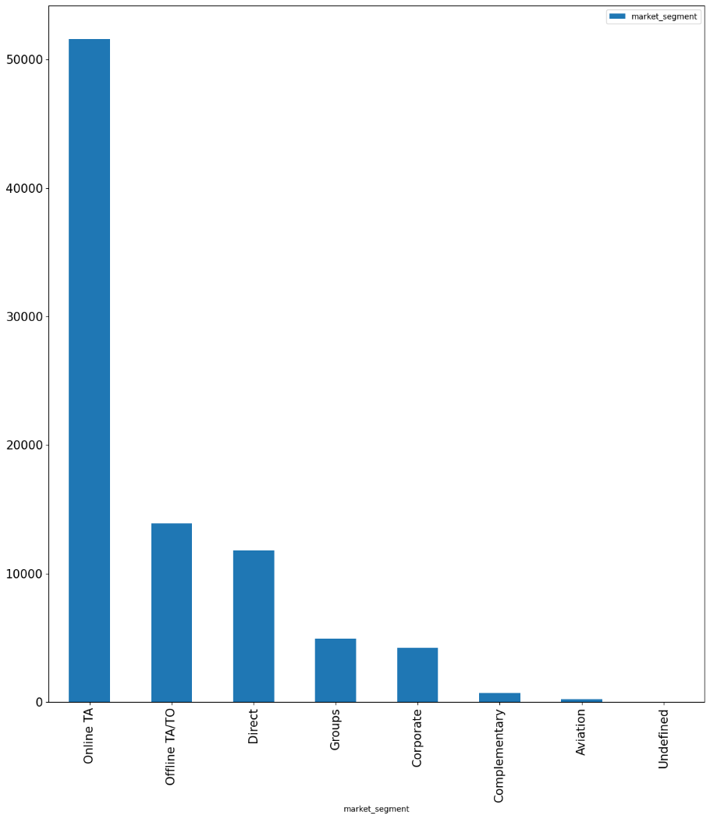
Market Segment
Online TA has been used most frequently to book hotel by the guest
Online TA/TO and Direct has approximately same number.

Slide 14
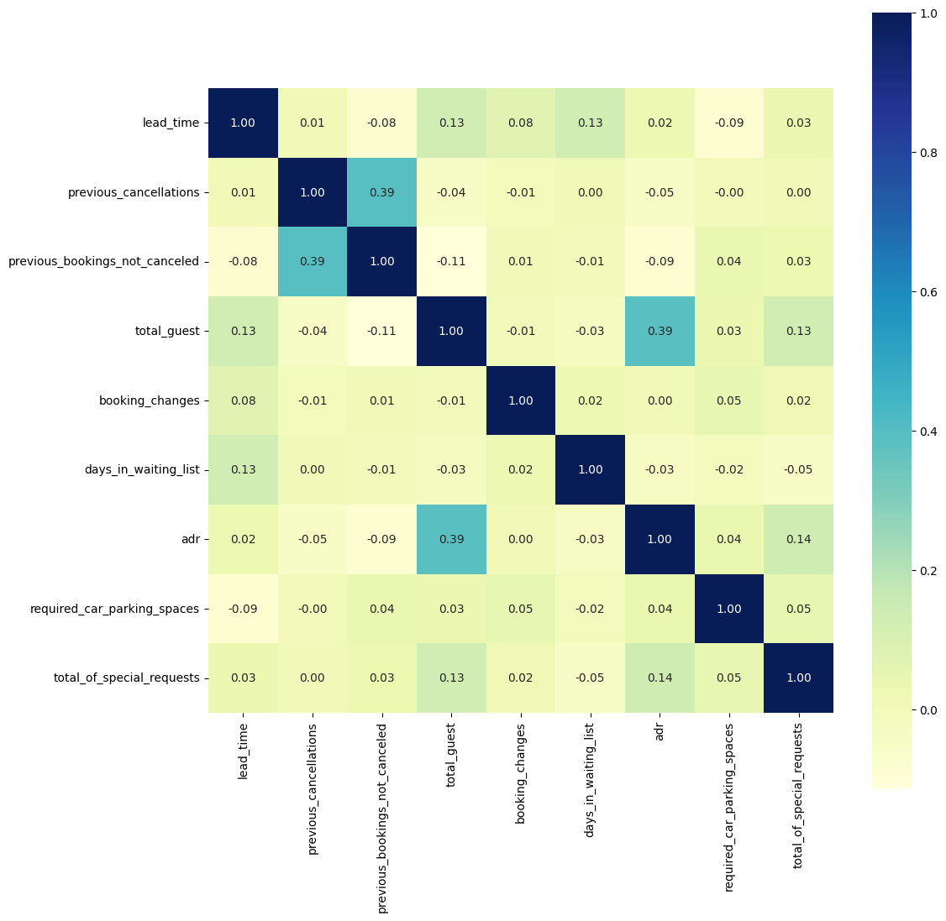
Lead-time and total stay is positively correlated means more is the stay of customer more will be the lead time.
ADR and total people ae highly correlated. That means more the people more will be ADR. High ADR means high revenue.
is_repeated_guest and previous_bookings Not_canceled has strong correlation. May be repeated guest are not more likely to cancel their bookings.

Slide 15
Conclusion
City Hotel retains more number of guests.
Room Type A is the most preferred room type than others room type.
Most number of bookings are made in July and August as compared rest of the other months.
City Hotel generates more revenue and profit.
Most number of guest stays for 1-4 days in the hotels.
New guest tends to cancel bookings more than the repeated guests.
More cancellation are from City Hotel.
Corporate has the most percentage of repeated guest while TA/TO has the least whereas in the case of cancelled bookings TA/TO has the most percentage while Corporate has the least.

Slide 16


